Slide 1
Dialogue on Economic Partnership Agreements (EPAs) with Business
16 December 2022
European Commission, DG TRADE

Slide 2
Agenda
1. EPAs – opportunities for business
2. EPAs implementation
3. EPAs: latest developments

Slide 3
1. EPAs: opportunities for businesses

Slide 4
32 countries implement an EPA
Solomon Islands

Slide 5
EU‘s biggest trading partners in ACP countries

Slide 6
EPAs benefits for business in the EU
Export opportunities
Improved market access (chemicals, pharmaceuticals, machinery, transport equipment)
Supply chain opportunities
EPAs have flexible rules of origin and allow for wide cumulation, so that local supply chains can be better organized
Import opportunities
Cheaper input materials (agricultural, agri-food, food-processing, texiles)
Improved business and investment environment
EPAs are negotiated in regional blocs, meaning they increase market sizes. Meanwhile, supporting programs focus on trade facilitation
Legal certainty and stability
EPAs are legally binding and provide dispute settlement mechanisms, so concessions can be enforced and cannot be unilaterally revoked
Notes:
1. Trade and investment ties are enhanced thanks to the overall improved business environment:
- International agreements setting rules of procedure, arbitrators, dispute settlement mechanisms etc.;
- legal certainty, stability and predictability;
- review processes and possibility of deepening and widening;
- monitoring of trade barriers;
- stable fora for dialogue on the implementation of the agreements (EPA Committees) - e.g. how to implement some provisions, barriers to trade which business may face, liberalization schedules, trade and sustainable development etc.
2. Integration with regional, continental and global value chains:
African EPAs and African Continental Free Trade Area (AfCFTA): EPAs with African partners support regional integration and favor intra-Africa trade and creation of continental value chains;
this is particularly relevant for EU businesses relying on value chains involving multiple African partners.

Slide 7
Increased trade between the EU and EPA countries
In 2021, EU's exports to EPA countries: 41 billion € and EU's imports from EPA countries: 39 billion €
+38 % value of trade EU-ACP EPA countries since 2008
Notes:
Overall EU’s trade with these countries increased from EUR 58 billion in 2008, when the first EPA started to be provisionally applied, to EUR 65 billion in 2020, representing a 13% increase in the value of trade in just over a decade. Over the same period, EU imports from these countries increased from EUR 31 billion to EUR 34 billion (9% increase) and EU exports increased from EUR 27 billion to EUR 32 billion (17% increase).

Slide 8
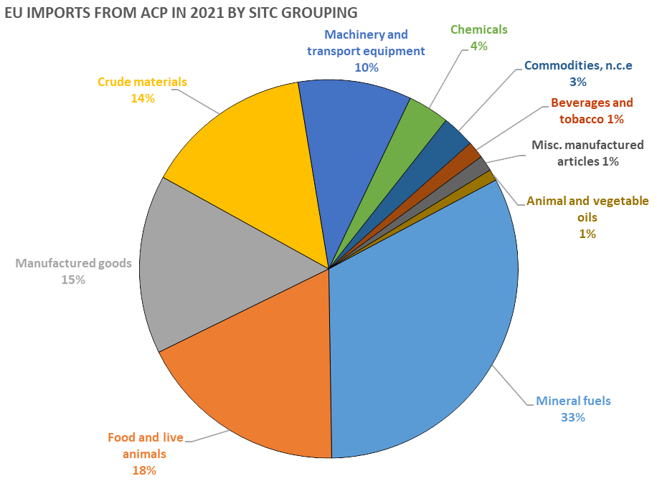
Main EU imports from ACP countries
EU imports mainly agricultural products and minerals/fuels from ACP countries.
Commodities still represent a large proportion of ACP-EU trade.
Recent export diversification trends: machinery and vehicles account for almost 10% of ACP’s total exports to the EU (mainly South Africa)

Slide 9
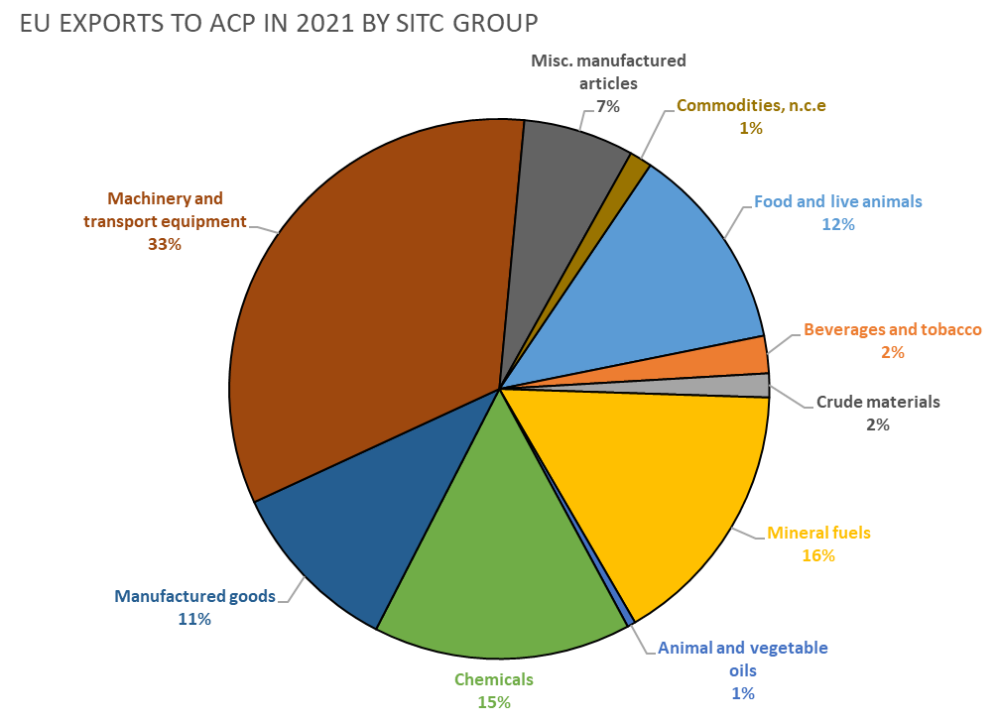
Main EU exports to ACP countries
Machinery and transportation equipment predominate in EU's exports to ACP (more than 30% of the total).
Refined oils and chemicals (half of it being pharmaceuticals) together account for 31% of EU's exports.

Slide 10
What EPAs cover
→ All EPAs cover:
trade in goods
market access (incl. safeguard measures/ trade defence mechanisms/ export taxes)
technical barriers to trade
sanitary and phytosanitary standards
joint Institutions (EPA Committees)
dispute settlement mechanism
→ Deepened EPAs cover all trade-related topics, such as:
services and investments
intellectual property rights
competition policy
public procurement
TSD
Notes:
- GIs are covered in SADC and Camerooon EPAs
- dispute settlement mechanism (for ESA5 DSM is under negotiation, for Ghana and Pacific negotiations for list of arbitrators are ongoing)

Slide 11
Access to EPA markets
Trade liberalisation schedule
Partner | End of liberalization
ESA EPA | 2022/2024
SADC EPA | 2026/2028
Ghana EPA | 2029
Ivory Coast EPA | 2029
Cameroon EPA | 2029
CARIFORUM EPA | 2033
Pacific EPA | 2038/2039
More info on specific products liberalisation at:
Access2Markets → https://trade.ec.europa.eu/access-to-markets/en/home

Slide 12
Rules of origin
ROSA (rules of origin self-assessment tool) → https://trade.ec.europa.eu/access-to-markets/en/home
 | Freely use input materials from… | General tolerance | Self-Certification | Single Transformation
iEPA Ghana | ACP & EU | 15%
iEPA Cote d’Ivoire | ACP & EU | 15%
Central Africa (Cameroon) | ACP & EU | 15%
ESA | ACP & EU | 15%
SADC | ACP EPA & EU GSP beneficiaries EU FTA partners MFN 0 materials | 15%
Pacific | ACP & EU | 15%
Cariforum | ACP & EU | 15%

Slide 13
EPA Committees
Committees for EPAs’ monitoring and implementation→ stable and regular forum for dialogue between parties.
EPA
Committees
Special committees
to discuss any issues concerning the implementation process, including:
liberalization schedules
trade irritants → ex. VAT on wine and spirits, antidumping duties (poultry, French fries, pasta), SPS measures on poultry etc.
Rules of origin and other customs issues are discussed in special committees on customs and trade facilitation.
To file complaints on trade irritants visit:
DG TRADE tools to tackle removal of trade barriers (Single entry point) + Gathering information from business (Complaints Office)→ Single Entry Point | Access2Markets (europa.eu)

Slide 14
3. EPAs implementation

Slide 15
Horizontal issues
1) Focus on implementation and enforcement of EU FTAs, including EPAs
EPA Committees
Follow up of implementation of market access schedules by partner countries
Setting procedures under EPAs (e.g. rules of procedure, arbitrators)
Setting up monitoring and civil society mechanisms
Policy discussions
Review processes
Monitoring of trade barriers
2) Awareness raising/ Communication on EPA benefits
3) Work with EU and ACP business

Slide 16
3. Latest developments

Slide 17
Latest developments:
Deepening (ESA5 EPA) and widening (SADC EPA: Angola)
EPA with Kenya – “variable geometry”
Sustainable Investment Facilitation Agreement (with Angola, ongoing discussions with Nigeria)
EPA review process (Cariforum SADC)
Multi-stakeholder dialogue on sustainability of cocoa
Impact of AfCFTA
Global Gateway

Slide 18
Investment facilitation: EU approach
Gap in our investment policy
Relevant provisions in other chapters
Lack of investment instruments in Africa
Link to the Global gateway

Slide 19
Investment facilitation: context
WTO “Investment Facilitation for Development”
AfCFTA Investment Protocol
EU bilateral approach: SIFA + EPA deepening

Slide 20
EU-Angola SIFA: content
Four main sections:
Predictability and transparency
Streamlining of authorisation procedures
Focal points and stakeholders involvement
Investment and sustainable development
WTO additions:
Transparency of investment incentives
Linkages with domestic economy
Investment and sustainable development
Development cooperation commitment
Bilateral channel to raise issue (+ civil society)

Slide 21
EU-Angola SIFA: expected benefits
New investors (incl. SMEs): transparency, authorisations
Existing investors: above + comment on new measures, publication in advance, grievance mechanism
Local economy: above + linkages, responsible business conduct
A wider package: accession to SADC EPA, EU development cooperation (cf. Sustainability Impact Assessement)

Slide 22
Thank you!

